Slide 1
Algorithm Analysis
Chapter-2

Slide 2



Slide 3


Slide 4


Slide 5
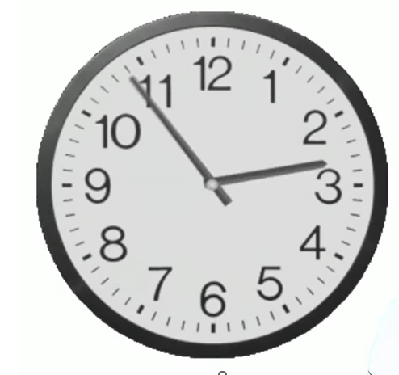

Slide 6

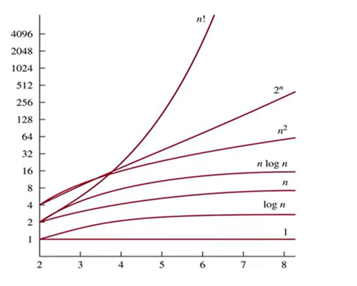
Order of Growth Studies

Slide 7


Slide 8

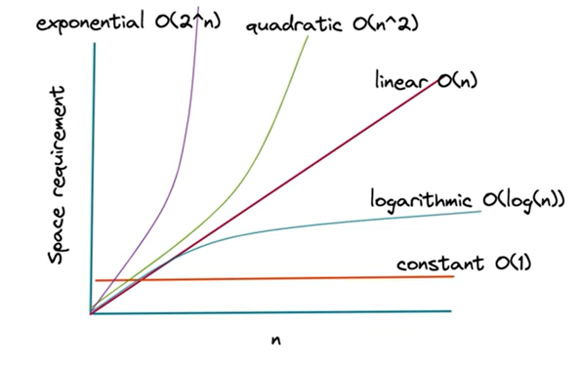
TIME

Slide 9
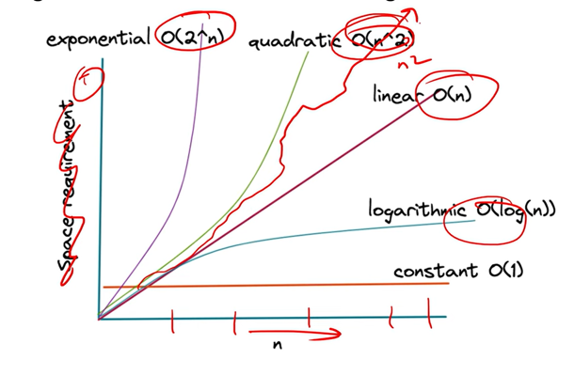

Slide 10


Slide 11
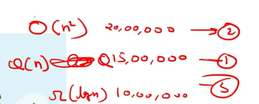


Slide 12

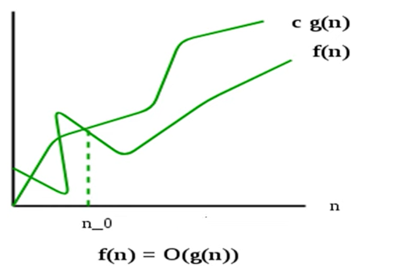

Slide 13

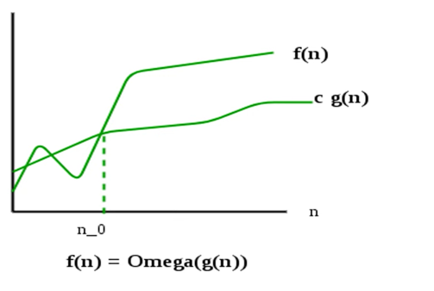

Slide 14
